Slide 1

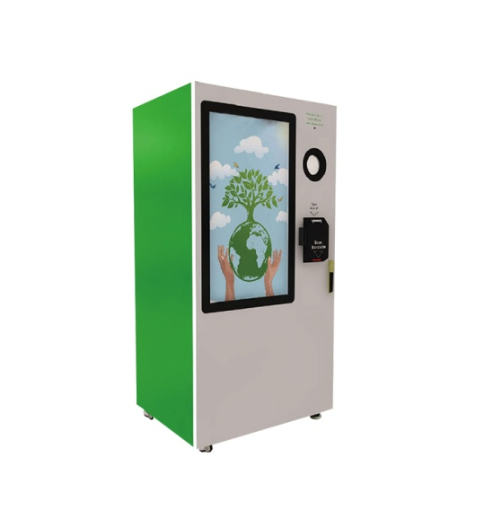
Reverse Vending Machine
“Bottle Safe”
Project elaborated by :
Chayma Ben Nacer
Khalil Ben Romdhane
Koussay Ben Mhanna
Mhadheb Ben Mahmoud
Mohamed Amine Lazreg
Mustapha Bouattour

Slide 2

Summary
1
Introduction
2
Data Preprocessing
3
3
Data Modelling
4
Data Visualization
5
Conclusion And Perspectives
2

Slide 3
Conclusion And Perspectives
Introduction
Data Preprocessing
Data Modeling
Data Visualization
Introduction
3

Slide 4
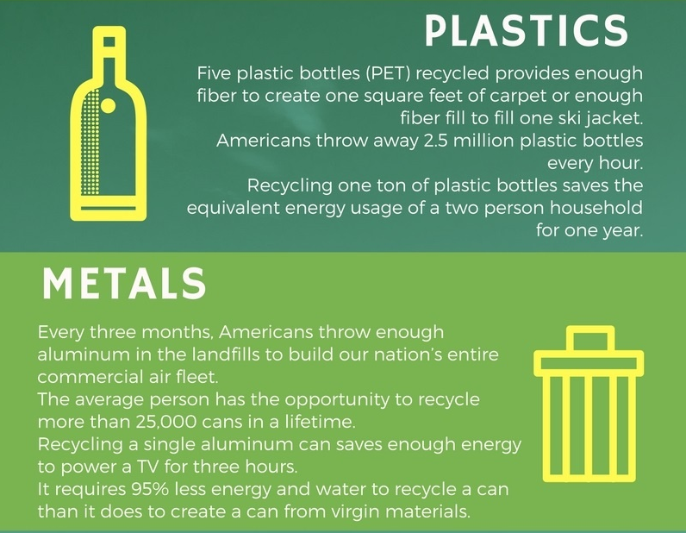
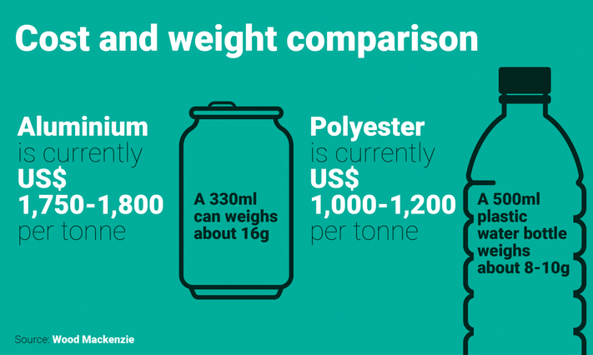
Problematic
A
B
4
Notes:
Finally, we tried to visualize the distribution of classes in each set.

Slide 5


What do we intend to make ?
Responsibility
Think ecology
Challenge
Improve Society
Recycle and Sort
5

Slide 6

Reverse Vending Machine
Easy to Use
Ecologic
Challenging
Low cost
6

Slide 7


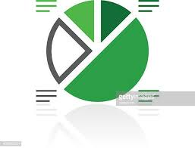
What can it do ?
A
- Collecting data .
- Execute our object detection model.
-Recognition and classification of inputs using Deep Learning algorithms .
-Implementation of facial recognition algorithm .
-Extraction and processing of the data collected from the machine .
B
7
Notes:
We collected different size of plastic bottles from different brand, and we tried to cover all kinds of cans

Slide 8
What can data do ?
 | Profiling
 | Key players of market
 | SFBT
 | Sabrine
 | Safia
Data interpreted
 | Insights
 | Factors affecting market
 | Raw material Price
 | Users tendencies
 | Marketing
 | Citizen awareness
Stats and visuals
 | Tracking
 | Competition
 | Coca-cola
 | Fanta
 | Viva
 | Sabrine
 | Safia
Modal prediction
 | Classify
 | End user's profiles
 | User consumption
 | Age group
 | Gender awareness
 | Occupation
 | Awards
User interface
Easy to change colors, photos and Text. You can simply impress your audience and add a unique zing and appeal to your Presentations.
8

Slide 9
Conclusion And Perspectives
Introduction
Data Preprocessing
Data Modeling
Data Visualization
Data Preprocessing
9

Slide 10
A
In our project we have 2 types of data:
External Data
Internal Data
B
10
Notes:
Thank you Mustapha . And now let’s move on to data preprocessing.
In our case we won’t be able to talk about variable and feature selection since we are the one’s who collected our proper data . So we have selected the features that we will need from the beginning .
So we will only talk about data preparation and data understanding.
So In our project we have 2 types of data: external data and internal data.

Slide 11
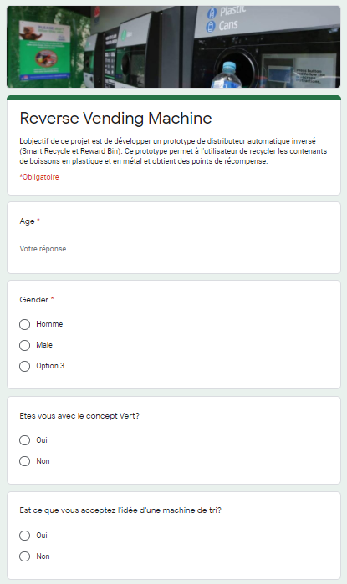
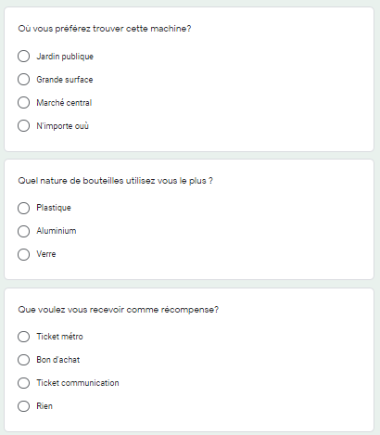
Data collection *
External Data
11
Notes:
Let’s begin by the external data.
We have created an online form that contains:
- Environmental questions
- Questions that are related to our business objectives
- And Personal questions

Slide 12
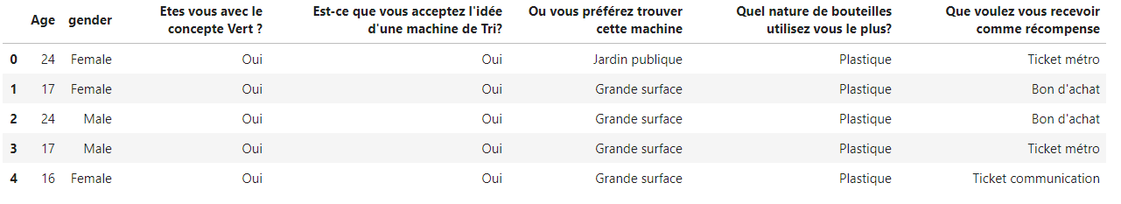
A
B
12
Notes:
And this is the data set that we got from this form.

Slide 13
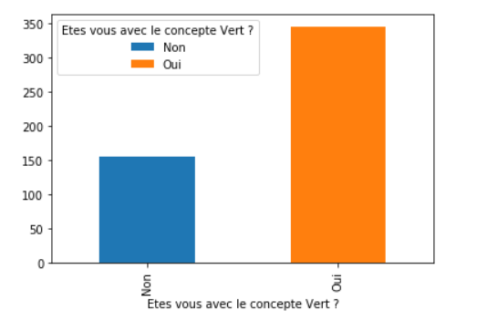
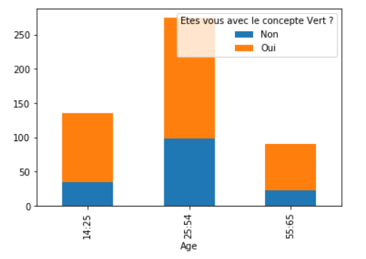
Graphs and statistics
A
B
13
Notes:
After collecting the data we have done many statistics and graphs and these 2 bar plots are an example.
These statistics will allow us to know if our project can be achieved or not, if the Tunisian society is interested by those kind of projects which are in relation with the principle of the green citizens.
Also we can deduce where we can put our vending machines and which type of gifts the client would like to get in return.
It will also help us in our business objectives such as Identifying the ecological profiles and classes of green citizens, profiling of key players in the market and drawing a competitive landscape for the market.
So as a result the external data will help us achieve many of our business and data science objectives .

Slide 14
A
Internal Data
The internal data are divided into 2 categories:
- The data related to the bottles and cans which will be used by our model.
- The data of the users collected through our machine.
B
14

Slide 15
Data collection *
Bottle Data Preparation
Phase A
Data collection
Phase
A
Phase B
Phase D
B
D
Data capture.
Phase
Phase
Data labeling.
C
Phase C
Phase
Dataset generation.
15
Notes:
So, in this part we're going to focus on cans and bottles data preparation, which has 4 phases

Slide 16
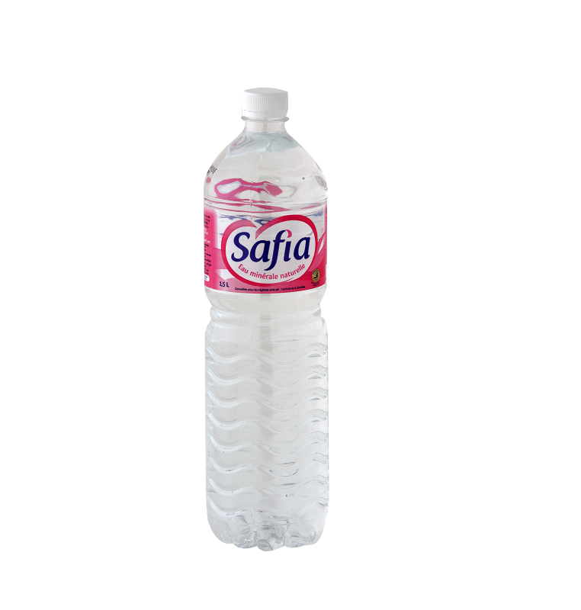
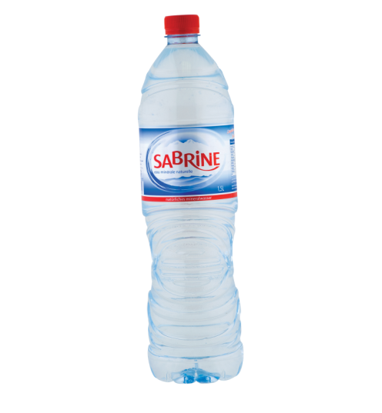
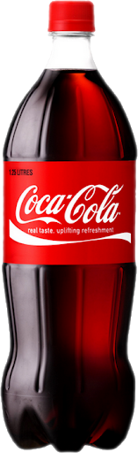
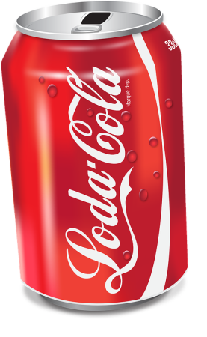
Phase A
A
- Collecting cans and plastic bottles :
B
16
Notes:
We collected different size of plastic bottles from different brand, and we tried to cover all kinds of cans

Slide 17
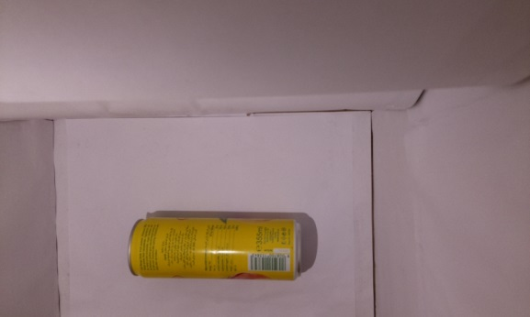
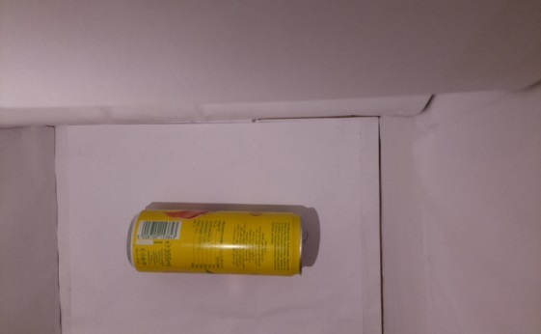
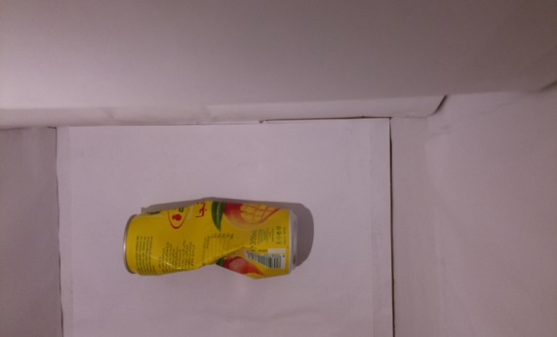
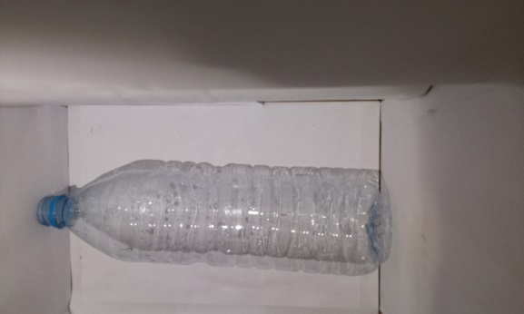
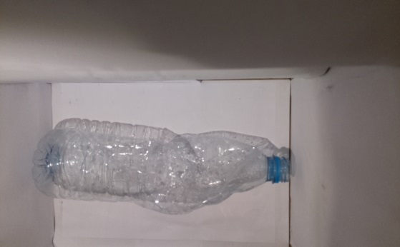
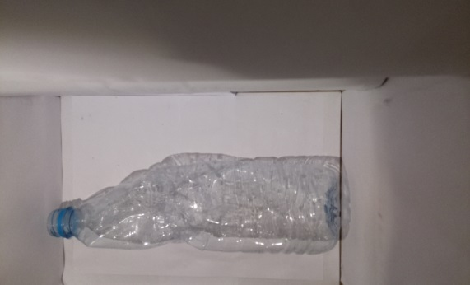
Phase B
A
- Data capture :
17
Notes:
So here we used the prototype of our reverse vending machine to take pictures of all the collected products, trying to change the position and the format each time

Slide 18
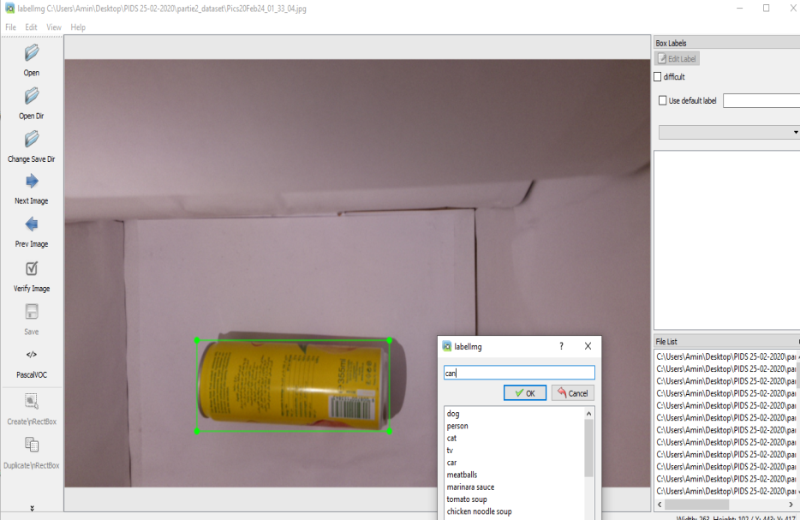
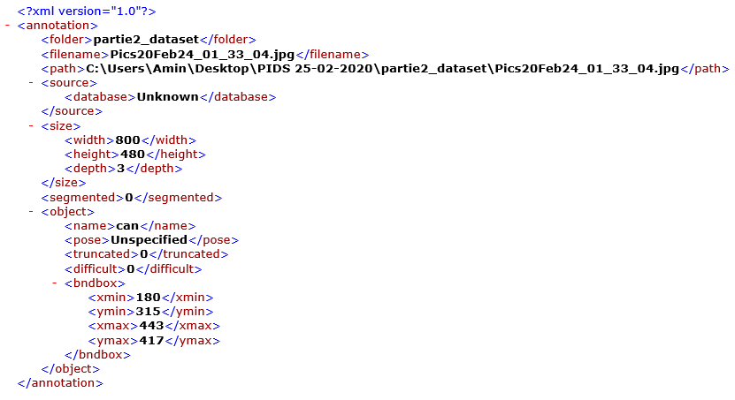
Phase C
A
- Data labeling :
B
18
Notes:
After we captured the data, we used labelImg to generate the xml files that contains several informations about the image like its width, height and depth, in addition it contains the coordinates of the target object and its class name.

Slide 19
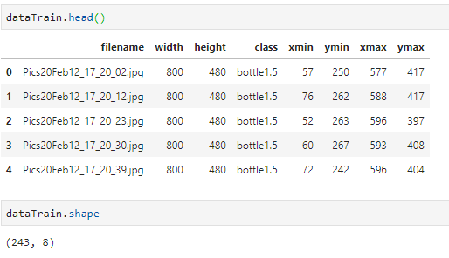
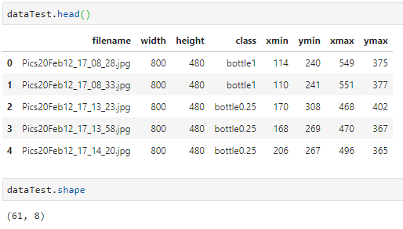
Phase D
A
- Dataset generation :
B
Train set : 80% ( 243 out of 304 )
Test set : 20% ( 61 out of 304 )
19
Notes:
For the final phase, we devided our labeled data to 80% train set and 20% test set, after that, we used pyhton code generate dataset using the xml files.
This two datasets contains the main information about each data

Slide 20
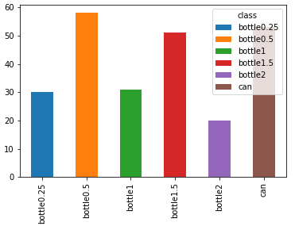
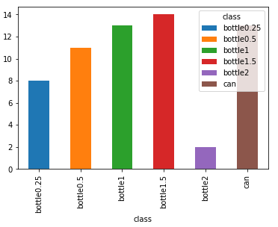
Phase D
A
- Dataset generation :
B
Train set
Test set
20
Notes:
Finally, we tried to visualize the distribution of classes in each set.

Slide 21
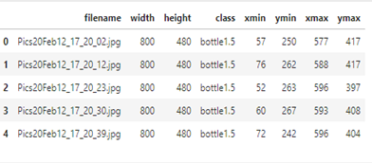
Data collection *
Bottle Data Comprehension
21
Notes:
Bech tahki aala les features mtaa el dataset hedhi (kima fel phase c) maaneha t9oul kharjna hedhom (width, height…) w tahki aalihom chwaya w akhaw

Slide 22
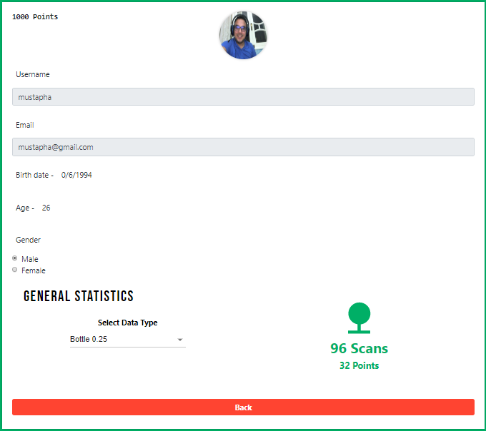
Data collection *
User Data Comprehension
22
Notes:
Lena bech tahki juste aala les données mtaa utilisateurs eli kharajnehom mel site mteena w tahki aalihom chwaya w akhaw

Slide 23
Conclusion And Perspectives
Introduction
Data Preprocessing
Data Modeling
Data Visualization
Data Modeling
23

Slide 24
Data modeling
4 phases
Phase A
Target models.
Phase
A
Phase B
Phase D
B
D
Models comparison.
Phase
Phase
Model training.
C
Phase C
Phase
Model evaluation.
24
Notes:
So, in this part we're going to focus on Data modelling, which has 4 phases

Slide 25
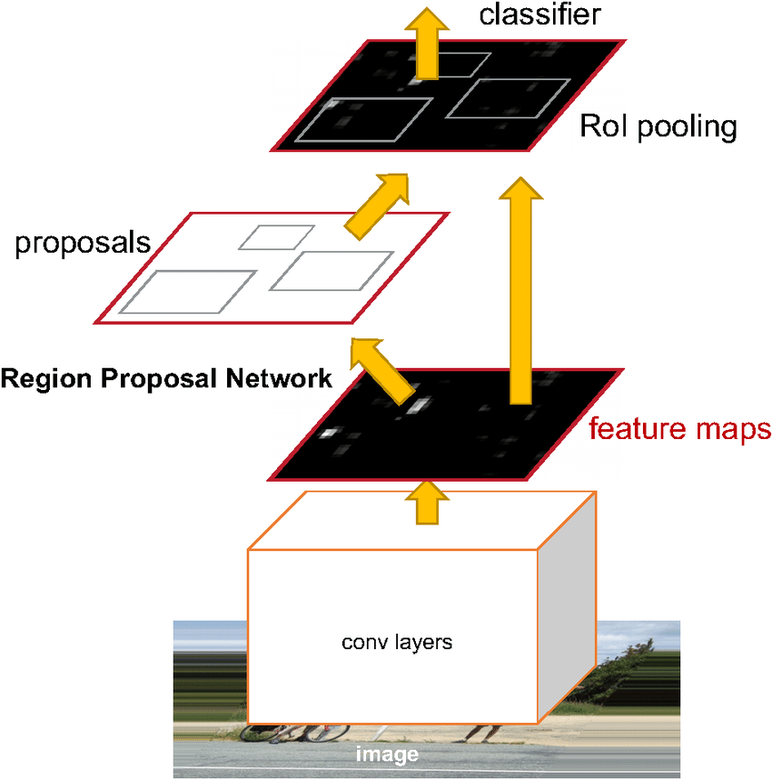
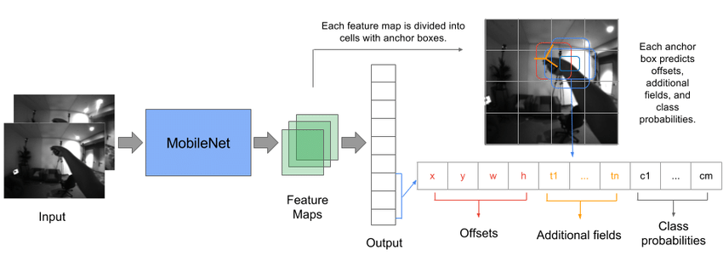
Phase A
A
- Target models:
R-CNN
SSD
B
25
Notes:
So as a first choice, we went for R-cnn which is resnet based, and ssd wich is mobilenet based, it wasn’t really a random choice, we did some researchs and we found out that both can be efficient for our project

Slide 26
Phase B
A
- Models comparison :
SSD ( 6000 steps )
R-CNN ( 3000 steps )
26
Notes:
We moved after that to the training and validation phases of the two models in order to compare them, as we can see here we 6000 steps for ssd mobilnet and it gave 77% of precision and 81% of recall, for r-cnn we stopped th training at 3000 steps and as we can see 75% for the precision and 85% for the recall, so comparing the number of steps and the evalutation metrics we can say that R-CNN is our best model here that we should chain our work with,

Slide 27
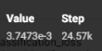
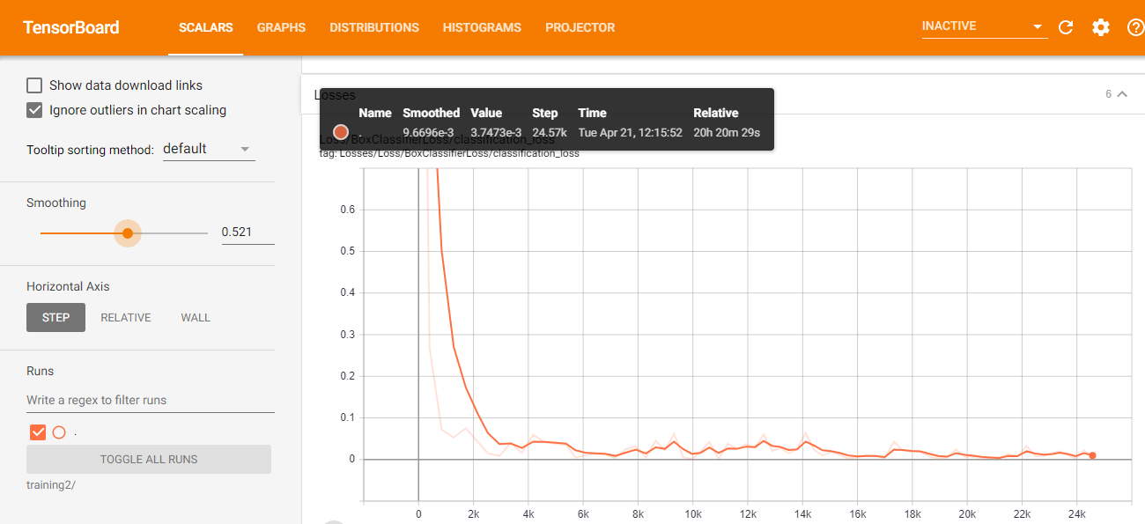
Phase C
A
- Model training:
B
27
Notes:
We displayed here the loss function in order to follow the decreasement of the cost according to steps increasement all over the training phase so we got 0,003 as a final value of the loss

Slide 28
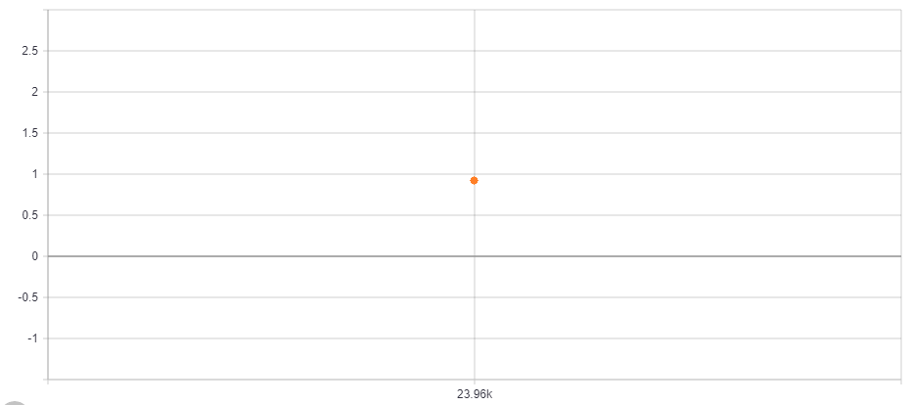
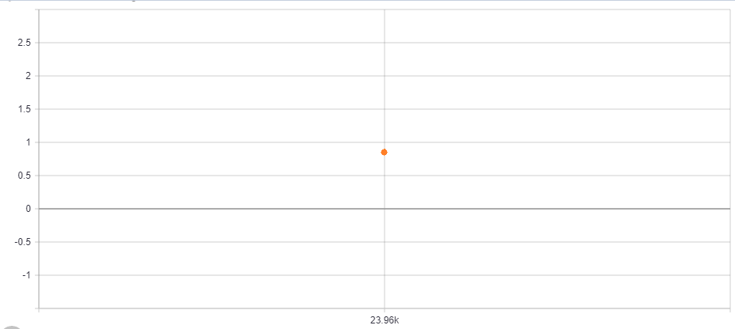
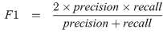
Phase D
A
- Model evaluation:
Precision : 94%
Recall : 88%
B
90,9%
28
Notes:
For the final phase, we evaluated our model by calculating its precision and its recall to end up with 0,9 as a F1 score value

Slide 29
Conclusion And Perspectives
Introduction
Data Preprocessing
Data Modeling
Data Visualization
Data Visualization
29

Slide 30
Data Visualization
Our website provides 2 types of data visualization:
User profile
Admin dashboard
30
Notes:
Thank you Amine
Let's move now to the data visualisation.
In fact we have to types of dashboards
the user profile
and the admin dashboard

Slide 31
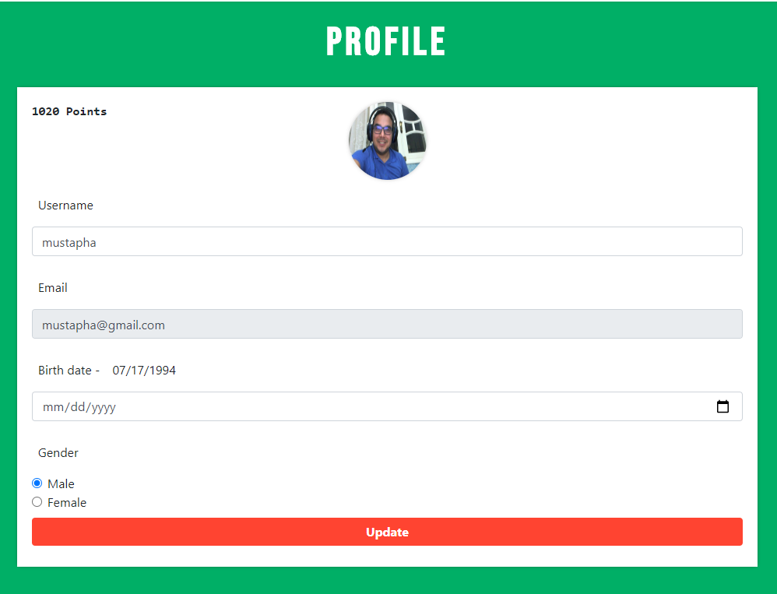
User Profile
31
Notes:
As you can see, the user can consult his profile. He can see his number of points and all his information.
He can also add his gender and his birth date.
Also he can modify his profile picture.

Slide 32
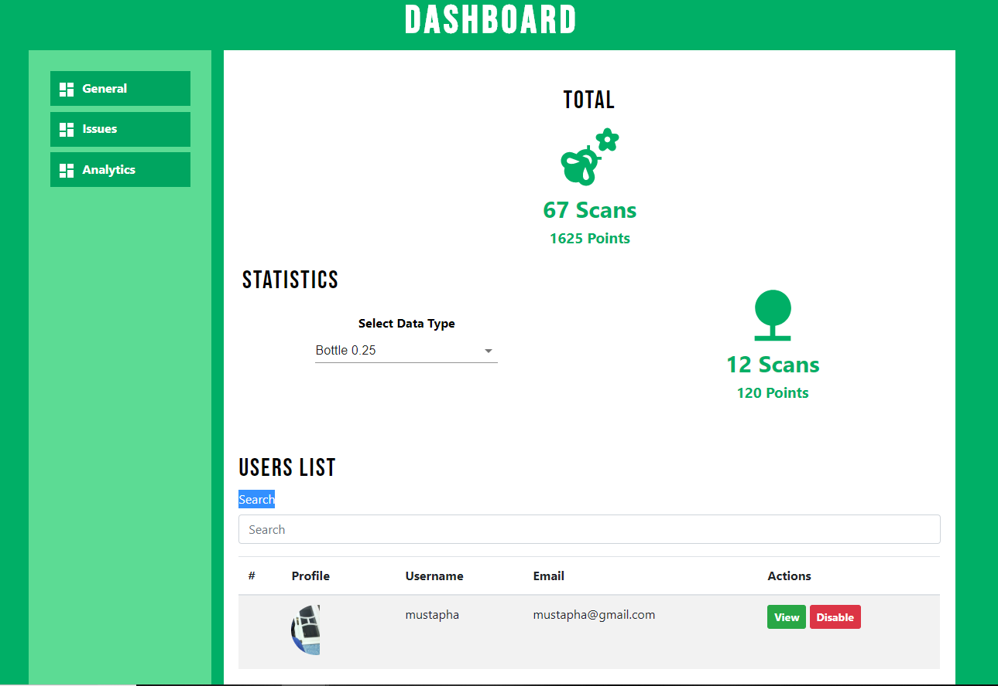
Admin Dashboard
32
Notes:
Let’s move now to the admin account and see the admin dashboards.
So as we can see we have 3 main sections: General information, issues and analytics.

Slide 33
Admin Dashboard
33
Notes:
So in the general section we can see the total number of scanned bottles and cans and the total number of points.
We can also get more details. So we can choose the type of bottle and the number of scans and points of this type will appear.
Then we can also find the list of all users and all the guests that have used the machine. We can even get the profile of the user by searching his username.
When we click the view button of the selected user we will get all the detailed information of that particular user.

Slide 34
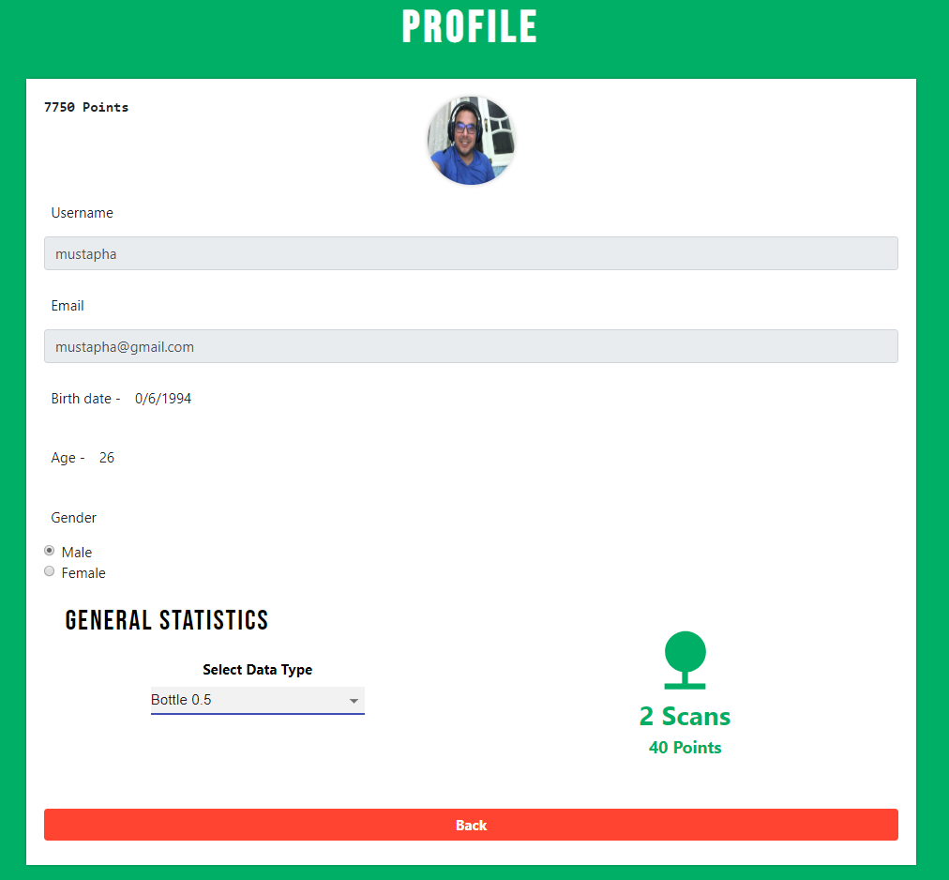
Admin Dashboard
34
Notes:
So we can see all the information related to this account. His number of points and his personal information.
We can also see the number of scans and points of each type of bottle for this user.

Slide 35
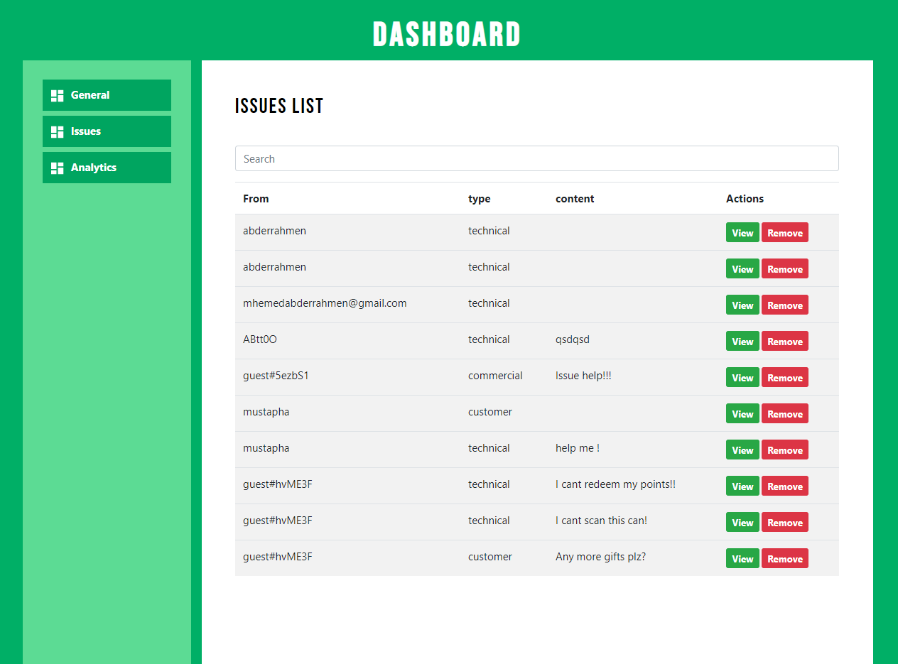
Admin Dashboard
35
Notes:
Let’s move now to the issues section.
In this section we can find all the messages sent by users or guests.
The messages can be related to either technical, customer or commercial issues.

Slide 36
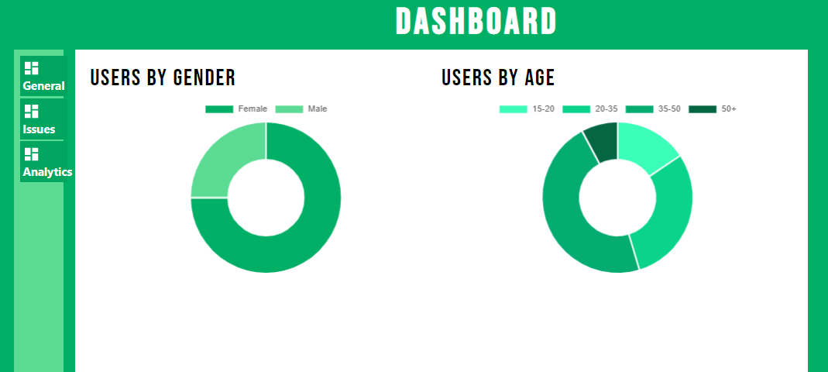
Admin Dashboard
36
Notes:
Let’s move now to the analytics section.
In this section we can find 2 pie charts.
These 2 charts give us the percentage of users by gender and by age range.
So to conclude and As you can see all these dashboards will allow the admin of the website to achieve the business objectives set at the beginning.
It permit the admin to identify the key players and the factors affecting the market. Also he can classify end user’s profiles.

Slide 37
Conclusion And Perspectives
Introduction
Data Preprocessing
Data Modelling
Data Visualization
Conclusion And Perspectives
37
Notes:
Smart Recycle and Reward Bin is meant to encourage the public to develop the habit for recycling by rewarding them with points. Thus, the machine should be located at public places such as shopping complexes.
Adding to that, The private sectors can play a major role by sponsoring the machines. Take for instance, the supermarket sponsors the machine and encourages its shoppers to recycle. In return, the shoppers apply for loyalty cards where they are able to collect their reward points. The reward points can be used to redeem shopping vouchers or goodies from the supermarket.
The machine has shown also that it is a good way of investment thanks to it's multiple sources of income (Sorted bottles, consumption data and advertising)

Slide 38
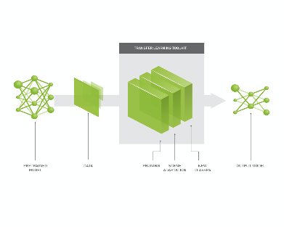
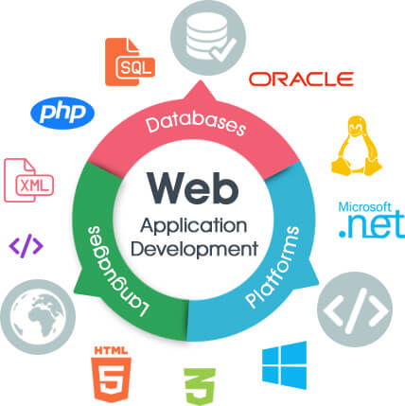
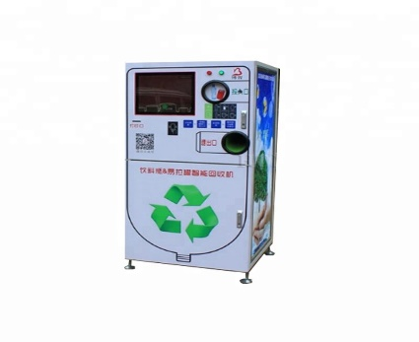
38
Notes:
For the final phase, we evaluated our model by calculating its precision and its recall to end up with 0,9 as a F1 score value

Slide 39






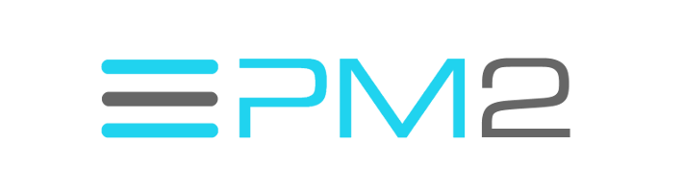


Tools
Tools & Technologies
39

Slide 40

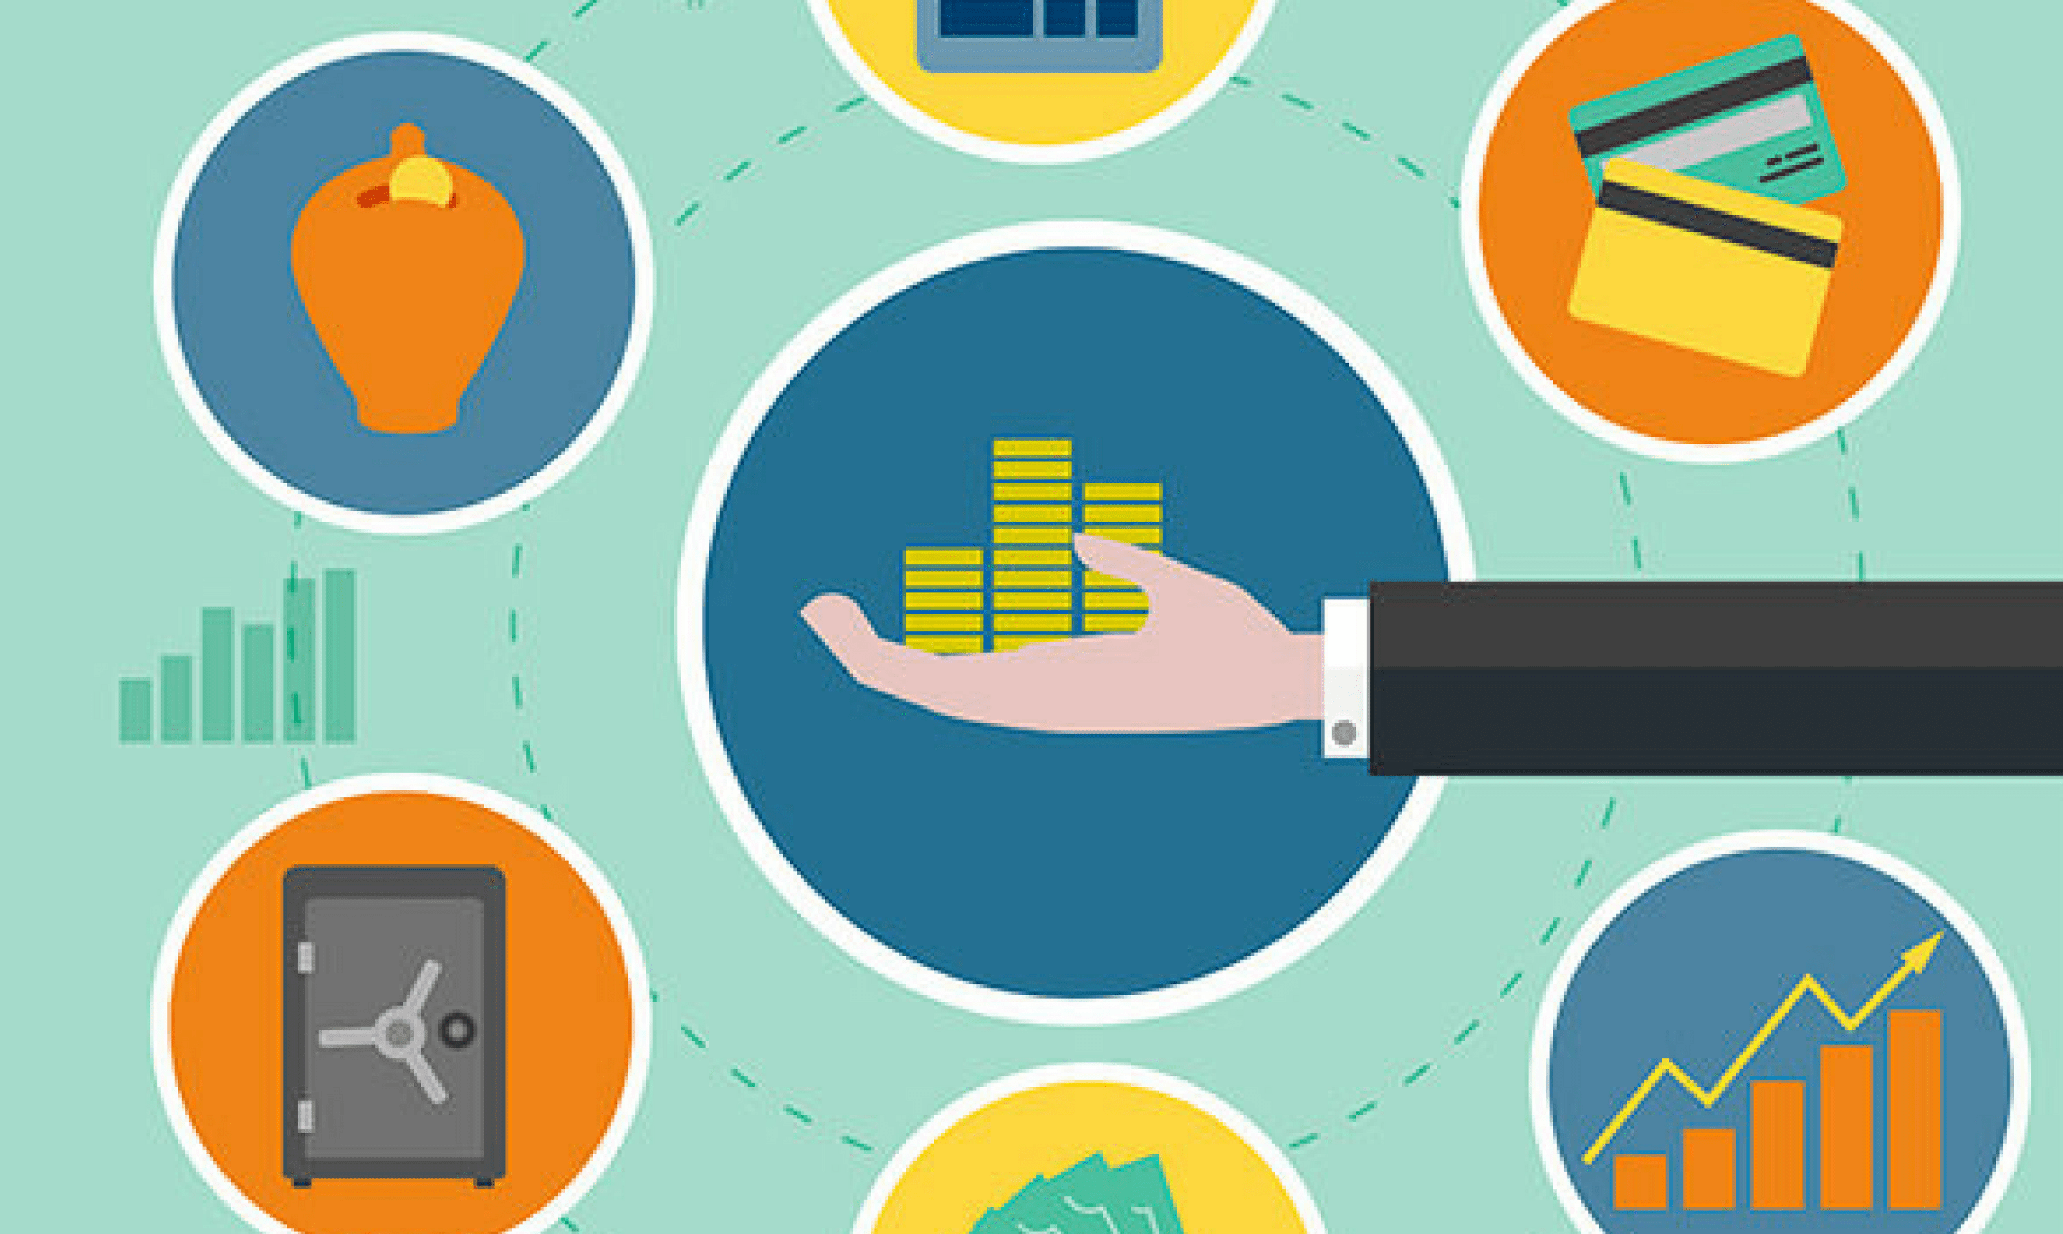
40
Notes:
For the final phase, we evaluated our model by calculating its precision and its recall to end up with 0,9 as a F1 score value

Slide 41

Thank you

